Slide 1
Modernizing Applications with Containers and Orchestrators

Slide 3
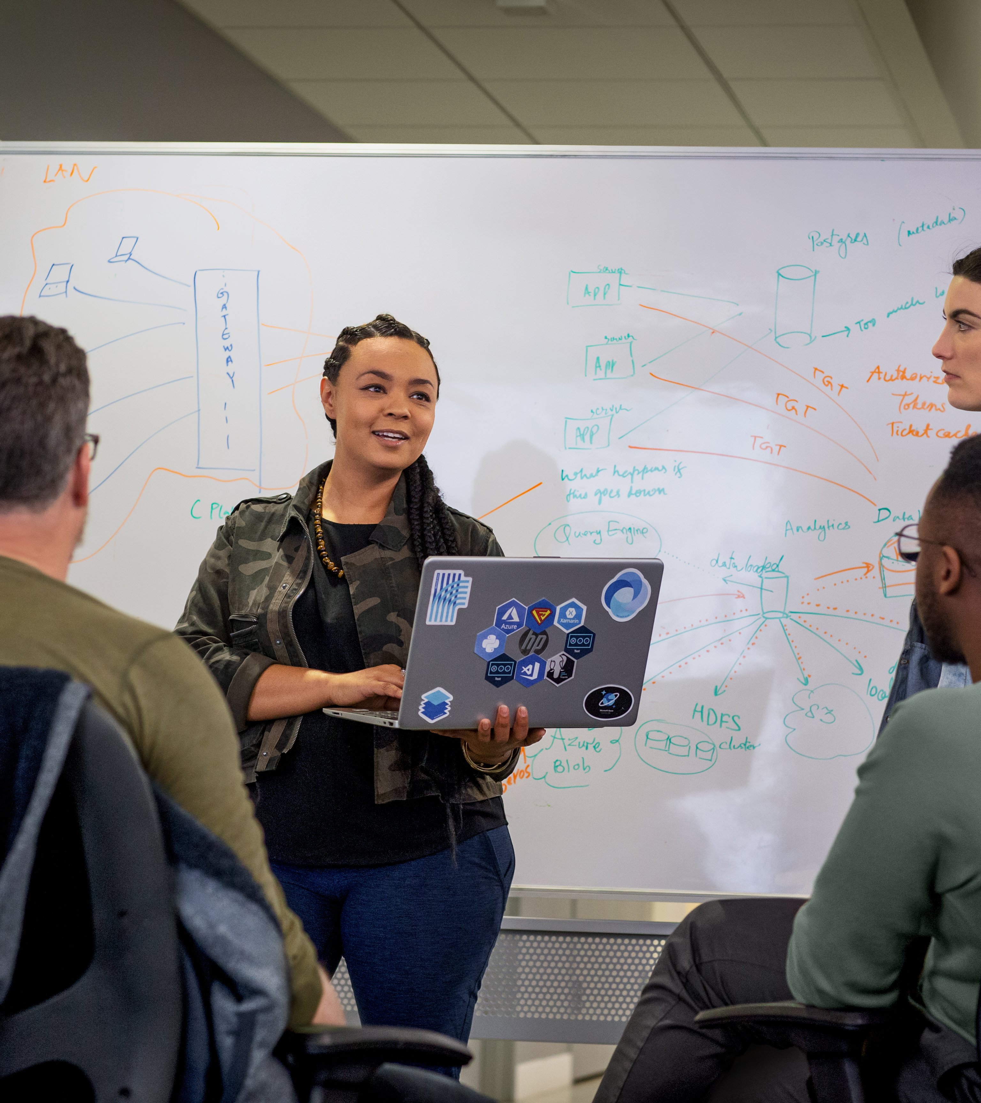
Day 1 Introduction to Containers Getting Started with Windows Containers Day 2 Advanced Docker Topics Microservices and Containers Container Orchestrators Day 3 DevOps with Containers Monitoring and Troubleshooting Containers
Agenda

Slide 4
Introduction and Logistics
Introductions
Your Name
Your Role
Any experience in Container/Orchestrator Tech
Your goals from this Training (something interesting)
Start and end times (09:00 am to 05:30pm) (IST)
Facilities i.c.y are attending from Office (rest-rooms, smoking, production calls..)
Break Times [ 11:00 am – Lunch (01:00pm) – 03:30 pm ] (IST)

Slide 5

Pradeep Nair Microsoft Services
Extensive years of Software Development Experience in Microsoft Technology
Worked with various MNC before joining Microsoft 7+ year back
Microsoft Certified Trainer
MCSD, MCSE, MCP
Certified Azure Solution Architect
TOGAF Certified Enterprise Architect
Technology Coverage
.Net Core, MVC 6, Angular
Azure, DevOps/GitHub, AI
Containers/Dockers/Kubernetes
Office 365, SharePoint
BTW, I am an Ex-Soldier from Indian Air Force

Slide 6
Introduction and Logistics
Introductions
Your Name
Your Role
Any experience in Container/Orchestrator Tech
Your goals from this Training (something interesting)
Start and end times (09:00 am to 05:30pm)
Facilities i.c.y are attending from Office (rest-rooms, smoking, production calls..)
Break Times [ 11:00 am – Lunch (01:00pm) – 03:30 pm ] (IST)
Use Lab time to explore, & rest of the time I request your focus and indulgence.

Slide 7



Setup Labs http://aka.ms/PremierEducation Training Key: CF435B67879A4042 Duration : 15 min
Notes:
Review lab setup instructions
Review logging into VMs
Show Azure Subscription and logging into account

Slide 8
Learning involves
Docker Images – CoreOS, Ubuntu, Nanoserver
Dockerfile – Building Custom Images
Docker Run - Running Docker Containers
Microsoft Windows Containers
Windows Server Core & Nano Server Images
Containers - IIS, ASP.NET 4.5 & ASP.NET Core
Docker Persistent Volumes
Docker Trusted Registries (DTR) & Self-Hosted Registries
Docker - Removing Images & Volumes
Microservices & Containers

Slide 9
Learning involves (Cont..)
Docker Compose – Defining multiple services
Docker & DevOps
Docker Tasks – DevOps Build/Release Pipelines
Container Registry (ACR)
CI/CD – Azure DevOps,
Intro to ACI & Azure Container Apps
Container Troubleshooting – Logs, Inspect etc.

Slide 10
Course Outline
Module 1: Introduction to Containers
Understand what Containers are
Learn Docker Fundamentals (Docker Engine and Client)
Understand Container Images & Docker Registry
Learn How to Build Container Image using Dockerfile
Learn how to Start, Stop, & Remove Docker Containers
Understand use of Tags for Versioning Images
Module 2: Getting Started with Windows Containers
Introduce Windows Containers
Understand the Microsoft and Docker Partnership
Explore Windows Container Images
Work with Dockerfiles
Build and run a variety of Windows containers
Learn about Visual Studio Support for Docker
Understand how to perform container updates

Slide 11
Course Outline
Module 3: Advanced Docker Topics
Docker container lifecycle
Docker Private Registry
Data management with Docker
Docker Compose
Limiting Memory and CPU for Docker containers
Docker Networking
Module 4: Microservices and Containers
What are Microservices?
Microservices Patterns
Microservices Real World Case Studies
Microsoft Platform and Microservices
Containers & Microservices

Slide 12
Course Outline
Module 5: Container Orchestrators
What is orchestration?
Microsoft offerings for containers
Azure Container Instance
Service Fabric
Additional options for orchestration
Introduction to Kubernetes
Introduction to MiniKube
Module 6: DevOps with Containers
Container DevOps value proposition
What is DevOps?
Azure DevOps overview ​
Containerized Workflow Pipeline ​
Azure DevOps: Continuous Integration ​- Windows/Linux
Azure DevOps : Continuous Deployment - SF/AKS​
Notes:
Azure Kubernetes Services & Azure Container Instances

Slide 13
Course Outline
Module 7: Monitoring and Troubleshooting Containers
Useful docker and kubectl commands for troubleshooting containers
Azure Monitor for containers
3rd Party Azure Partner Solutions
Notes:
Samples when to use an actor:
For every user of your mobile app you could have one actor.
For every thermostat that sends information to your application you could have one actor.
For every customer of your e-commerce site, you could have one shopping-basket actor.
Create a reliable service that provides a service for multiple users at once. For example a weather service.

Slide 14
Module 1 - Introduction to Containers

Slide 15
Objectives
Understand what Containers are
Learn Docker Fundamentals (Docker Engine and Client)
Understand Container Images and Docker Registry
Learn How to Build Container Image using Dockerfile
Learn how to Start, Stop, and Remove Docker Containers
Understand use of Tags for Versioning Images
Microsoft Partnership with Docker Inc.

Slide 16
Understanding the Use Case for Containers
Physical Servers
Virtual Machines
Containers
Notes:
Physical server bought –
Unused capacity and waste of manpower
VM
Full copy of OS/ Licensing / Patch/ Slow to bootup
Container
Evolution of VM or OS
Shared Kernel
Boot fast/ Portability
Run everywhere same

Slide 17
Challenges with Virtualization
Notes:
Left - Architecture of multi VM system => shared hardware, duplicated OS
OS duplicated – no value for business users (most of the time).
Running a Host is demanding maintenance, resource, time to boot/scale/reproduce configuration

Slide 18
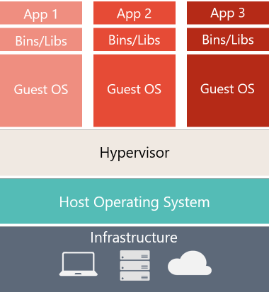
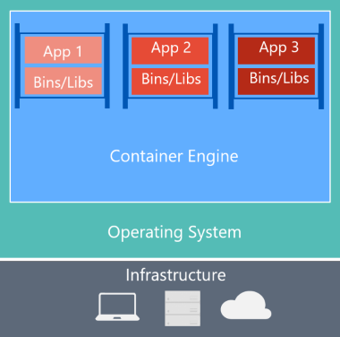
Virtual Machines versus Containers
Virtual Machine
Container
Notes:
Left: duplicated OS
Right: Container architecture:
-> Share the OS
-> Container layer => translate OS ⬄container interactions => runs on the host
-> From a host standpoint, containers are processes (managed by the docker engine) running in parallel
-> From a container standpoint, my application is running on an isolated machine: I have my own file system.

Slide 19
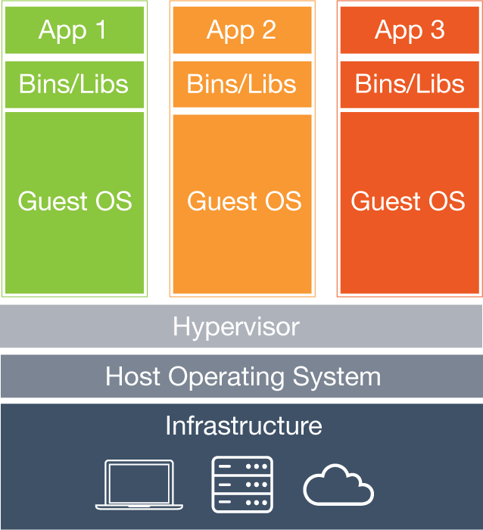
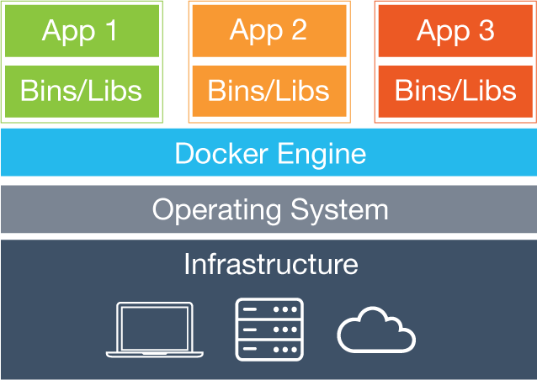
Virtual Machine versus Containers
Virtual Machine
Container
Container
https://www.docker.com/what-docker
Notes:
Left: duplicated OS
Right: Container architecture:
-> Share the OS
-> Container layer => translate OS ⬄container interactions => runs on the host
-> From a host standpoint, containers are processes (managed by the docker engine) running in parallel
-> From a container standpoint, my application is running on an isolated machine: I have my own file system.
WindowsServer & Nanoserver which is a copy
Docker engine do the heavy lifting (runs on Linux and Windows)
Container don’t have a full copy of OS
Share the OS Kernel of the Host OS
Container are also isolated, idea is to minimal and light weight
Docker Client (API) to built the everything

Slide 20
Understanding the Use Case for Containers
Traditionally
Install, configure and maintain IIS and ASP.NET app
Install, configure and maintain IIS and ASP.NET app
Install, configure and maintain IIS and ASP.NET app
Development
Test/Staging
Production
Notes:
Dev – Do dev with env config, HW/SW etc
Test
Production

Slide 21
Understanding the Use Case for Containers
Container World
Install, configure and maintain IIS and ASP.NET app
Development
Container image
Test/Staging
Production

Slide 22

Understanding Docker
Notes:
Container is not new, and was built in Linux as LNX
Microsoft contributed to Docker Open Sources Project
Partnered with Docker team to come up with the

Slide 23
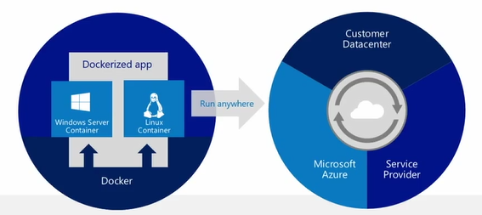
What is & Why Docker?
Build any app in any language using any stack (OS)
Dockerized apps can run anywhere on anything
No more “It works on my machine”
No more dependency daemons so Developers and System admins unite
Docker makes it easy to install and run any software with worries
Notes:
Container technology called Docker => another competitor like rkt (Rocket)
Package your system/component with all needed dependencies
[Start with the diagram.io]
Host independent -> no particular install on your host except Docker daemon/engine
If it works on my machine, it will work everywhere.
Inner loop debugging
Installing Software
Download Installer → Run Installer
Loop : Get an Error message during installation
Troubleshooting issues → Rerun installer
Loop : Get another Error
MAKE LIFE EASE (Redis example – docker run –it redis)

Slide 24
Key Container Terminology and Concepts
 |  | Docker.exe docker run
Docker Client
Container
Server Core / Nano Server
Docker Remote API
Docker Server/ Engine
Daemon / Service
GET /images
POST /containers/create
Windows Server 2019 Container Support
 |  | Container Host
Notes:
What is Docker :
Image (single file with dep and config)
Containers (instances of an image in a running state)
Windows 2019 : Host machine which here is a 2019 (physical or vm) with native Container feature installed now called or referred as Container Host
Docker Engine : You install Docker Engine you will interface with to launch the container.
Containers : Spinning up containers using some images
Docker Client: you will use some interface or client, which is tool to issue command which talk to Docker Engineer

Slide 25
Docker Vocabulary
Host A VM running the Docker Daemon to host a collection of Docker Containers
Client Where docker commands are executed ^{(client/server)}
Image An ordered collection of filesystems (layers) to be used when instancing a container (more on it later)
Container A runtime instance of an image
Registry A collection of docker images
Notes:
Host -> where the containers run (Docker daemon)
Client -> docker CLI
Image -> Definition of the container. Describing dependencies. Decomposed in Layers (see Dockerfile).
Container -> Instance of Image
Registry/repository -> Store and distribute images.

Slide 26
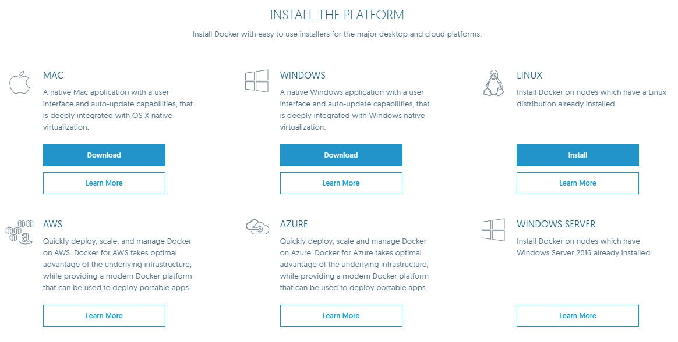
Understanding Docker
https://www.docker.com/products/overview
Notes:
How to install and it can be overwhelming
All version are available for Dev and Prod
Linux Container on Windows 10 ? → Docker engine inside a Linux VM (container Host), you can Linux container host and Docker SW allow you to switch to Windows Containers Host
U can different platform
We are going to use Windows Server containers

Slide 27
Containers
Applications traditionally built and deployed onto physical systems with 1:1 relationship
New applications often required new physical systems for isolation of resources
Package and run apps within
Containers
Physical
Physical/Virtual
Higher consolidation ratios and better utilization
Faster app deployment than in a traditional, physical environment
Apps deployed into VMs with high compatibility success
Apps benefited from key VM features i.e. Live migration, HA
Key Benefits
Further accelerate of app deployment
Reduce effort to deploy apps
Streamline development and testing
Lower costs associated with app deployment
Increase server consolidation
Virtual
Notes:
Evolution towards containers
Physical:
1 host for 1 app =>
Good isolation
Time to scale = buy new machine
Bad resource utilization (machines sit there doing nothing)
VM:
1 VM for 1 app =>
Better resource utilization
Isolation
Portability => duplicate VM
Dynamic scale out
Container:
1 app for 1 container =>
Better utilization => time to scale out
Portability (reproductive configuration => pet/cattle),
Inner loop => time to test decreases

Slide 28
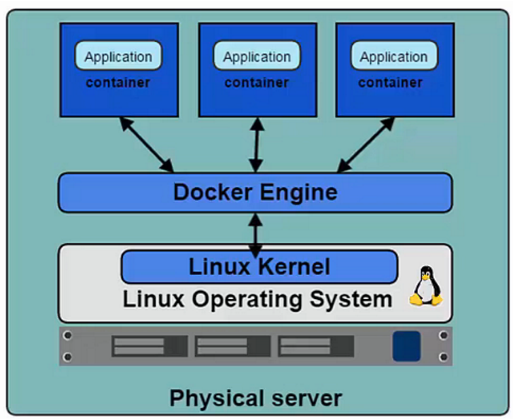
Docker Platform
Docker Engine (a.k.a. Docker Daemon)
The program that enables containers to be built, shipped, and run.
Uses Linux Kernel namespaces and control groups to give an isolated runtime environment for each application
Docker Hub
An online registry of Docker images
Docker Trusted Registry
Private on-site Registry for Docker images
Notes:
Let’s describe Docker platform:
Docker => industry standard
Engine ⬄ Daemon => runtime to run & manage container.
=> interact with the Linux Kernel
But you Cannot containerize everything -> example: usage of kernel related features (Windows registries).
Initially based on Linux OS with OS specific components (namespace, control group for isolation) => release in Dec 2013
Docker Hub => store your images online
Docker trusted registry => implement Docker Hub on premises

Slide 29
Docker Platform (Cont.)
Docker Client
Container Registry
Repository
Container Host
My App v1
Container Image
Docker Client
Container Host
Notes:
How to transport the images
U would use Container register (your hosted register or public registry like docker hub)
Registry will have repository which store the images
U can use the Docker client to pull the images to your Host to build Containers
AWS, Amazon, Google etc.

Slide 30
Docker Platform (Cont.)
Container Registry (Public or Private)
Repository 1
Repository 2
Web App v3
DB App v2
Web App v2
DB App v1
Web App v1
Notes:
These registry can have multiple version of your images under multiple repository
Repository are the place where your images live
On Win

Slide 31
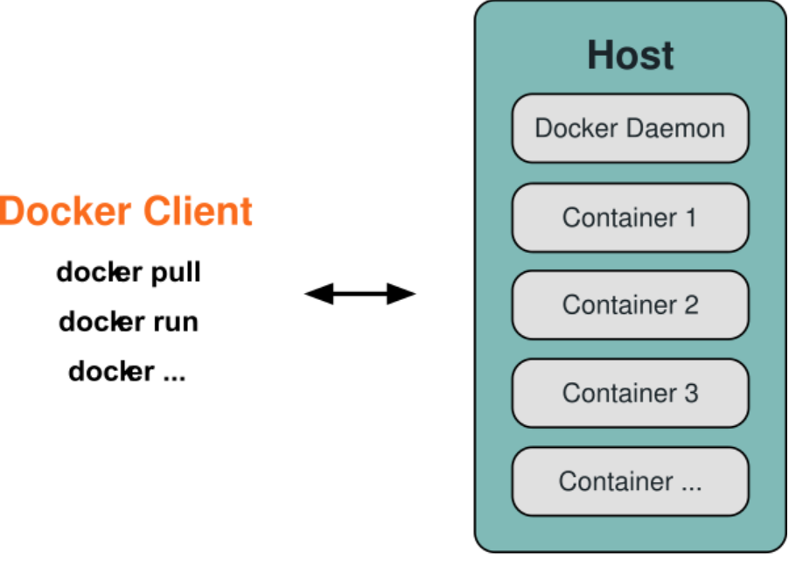
Docker Platform (Cont.)
Docker Client
Takes user inputs and sends them to the Daemon.
Client and Daemon can run on the same host or on different hosts.
Docker Images
Read-only template used to create containers.
Contains a set of instructions for creating the containers.
Docker Containers
Isolated application platform based on one or more images.
Contains everything needed to run your application.
Notes:
Docker client => CLI -> commands to interact with the daemon
Docker Images => definition of your container => list dependencies, how to install / them set them up.
Docker container => image instance. Snapshot of your image available to be run.

Slide 32
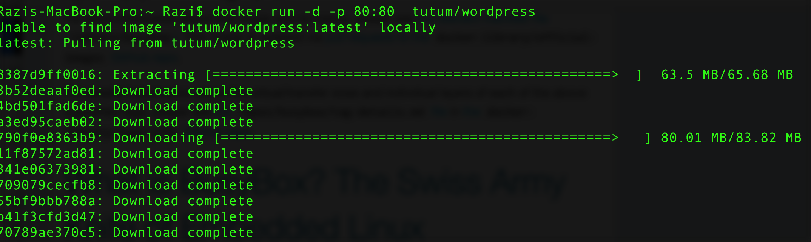
Quick Question?
How fast you can launch a fully functional WordPress blog engine?
How about multiple WordPress blog engines running side by side on same host?
Notes:
Who has you ever tried to launch a WordPress blog engine? Multiple instances running side by side on the same host
=> Long process => set up mySQL, PHP, Apache, … it can take hours depending on the method.

Slide 33
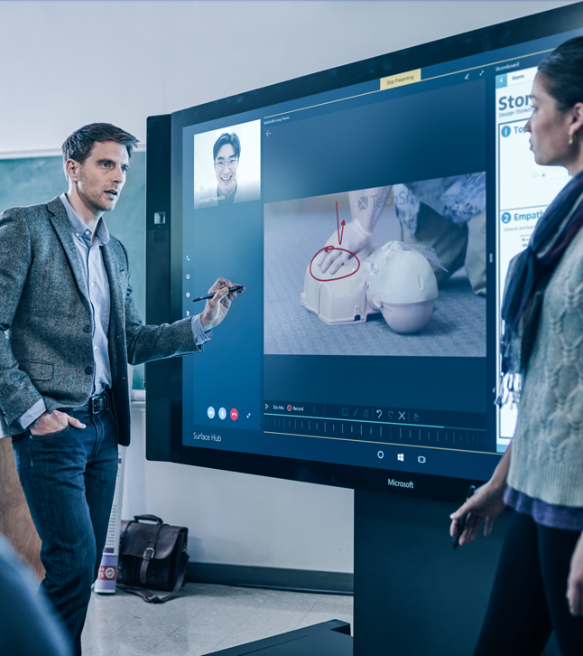
Demonstration: Running Docker Containers
Launch a single WordPress Container
Running multiple WordPress Containers side by side
Notes:
For detail instructions please refer to Module 1 - Demos document section Demo 1: Running Docker Containers.
Show :
WSL2 (Windows Subsystems for Linux) : https://docs.Microsoft.com/en-us/windows/wsl/install-win10
Docker Desktop: https://docs.docker.com/docker-for-windows/wsl/

Slide 34
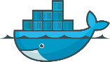








Docker In Action
Client
DOCKER_HOST
Registry
Docker pull
Docker daemon
Docker run
Containers
Images Cache
WordPress
WordPress
Notes:
As a Summary of the demo
Locally we had Docker CLI + Docker HOST (the blog ran locally on my machine)
Remotely we accessed a repository of image with the wordpress image.
Docker CLI => to interact with containers on your machine
Docker Daemon to run them on your machine
Image cached for fast pulling
Public images available in Docker registry

Slide 35
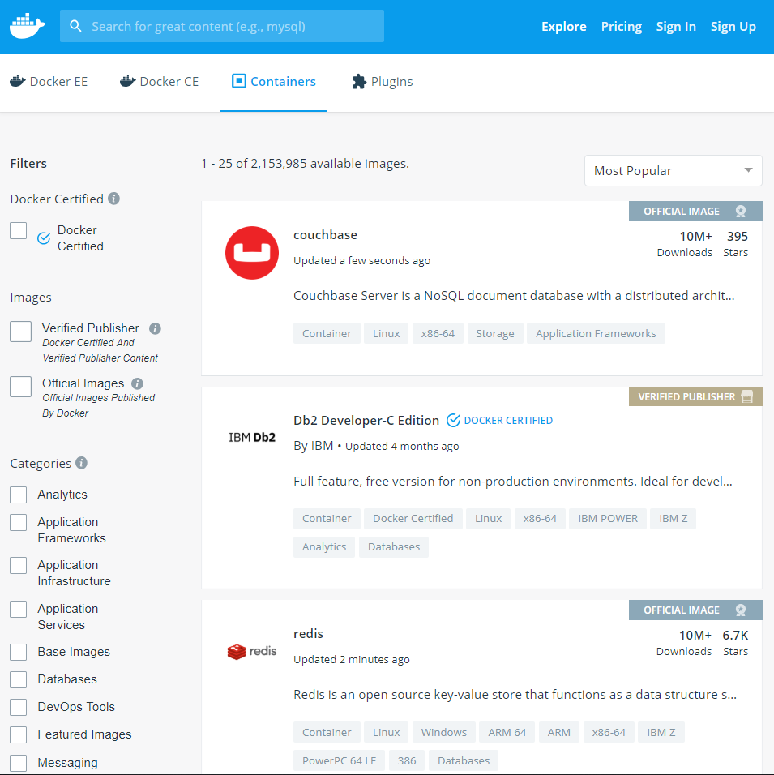
Docker Registry
Stores docker images
Searchable
Public Registry – hub.docker.com
Private Registries – Instanced for you. E.g. Azure Container Registry, Docker Private Registry, Self-Hosted Registry
The Registry is open-source under the permissive Apache License
Notes:
Docker registry
-> Repository of images
-> discoverable/searchable
Hub.docker.com
Azure Container Registry
Standard protocol to implement your own registry (the CLI can connect with it).

Slide 36
Demonstration: Docker Registry
Search Docker Registry using Docker CLI
Search Images on DockerHub
Docker Image Naming Convention
Notes:
For detail instructions please refer to Module 1 - Demos document section Demo 2: Searching Container Image on Docker Hub

Slide 37
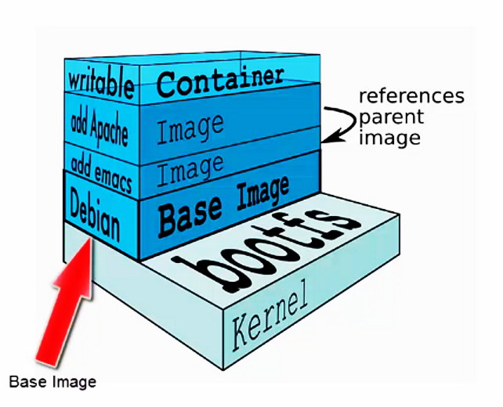
Docker Images
A Docker image is built up from a series of layers.
Base platform OS image is provided by vendors like Microsoft for Windows OS image, Canonical for Ubuntu image etc. These images get published to DockerHub.
Each layer represents an instruction in the image’s Dockerfile.
Each layer except the last one is read-only.
Notes:
Docker images
Composed of Multi layers. Why?
Optimized for caching and sharing
Bottom layer = base OS.
Example of base OS:
alpine => very lightweight, not even a bash installed
Windows base OS => bigger than Linux base OS but it is decreasing
In Dockerfile (⬄Instructions to build your image) => 1 instruction = 1 layer.
Only top layer is writeable.

Slide 38
Demonstration: Docker Image Layers
List All Layers for Docker Image
Look at locally cached images
Notes:
For detail instructions please refer to Module 1 - Demos document section Demo 3: Inspecting Docker Layers
Delete /bin/cat (rm bin/cat) file in container then show RW Layer using docker diff <container id>
as files are modified in a running container the original image is not changed. The R/W layer ‘records’ those changes
Create and image from R/W layer using docker commit
This creates a new images that is identical to the original except a new layer is added containing the changes (/bin/cat removed)
docker export <container id> -o outfilename.tar.gz
Use 7-zip to view archive and filesystem

Slide 39
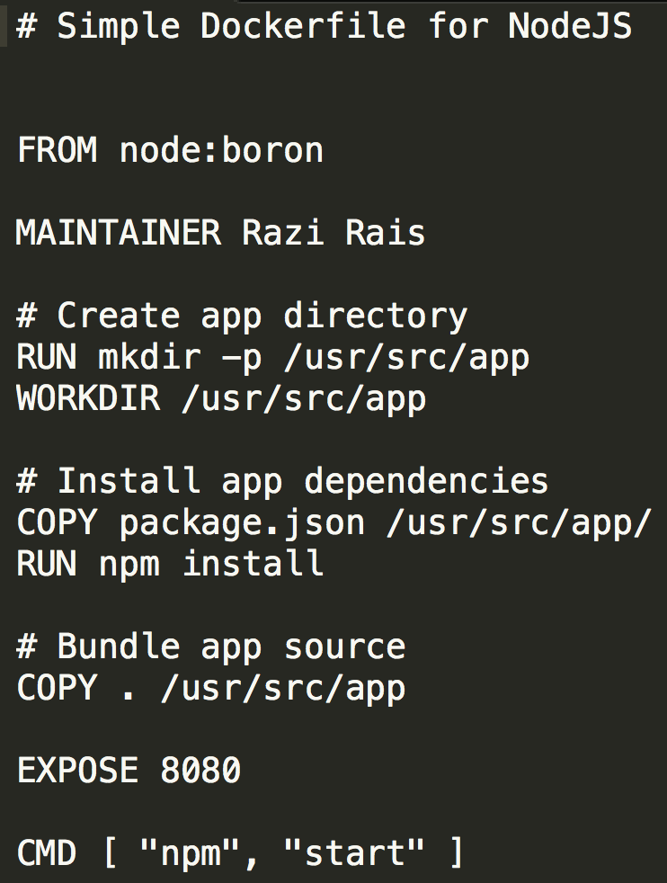
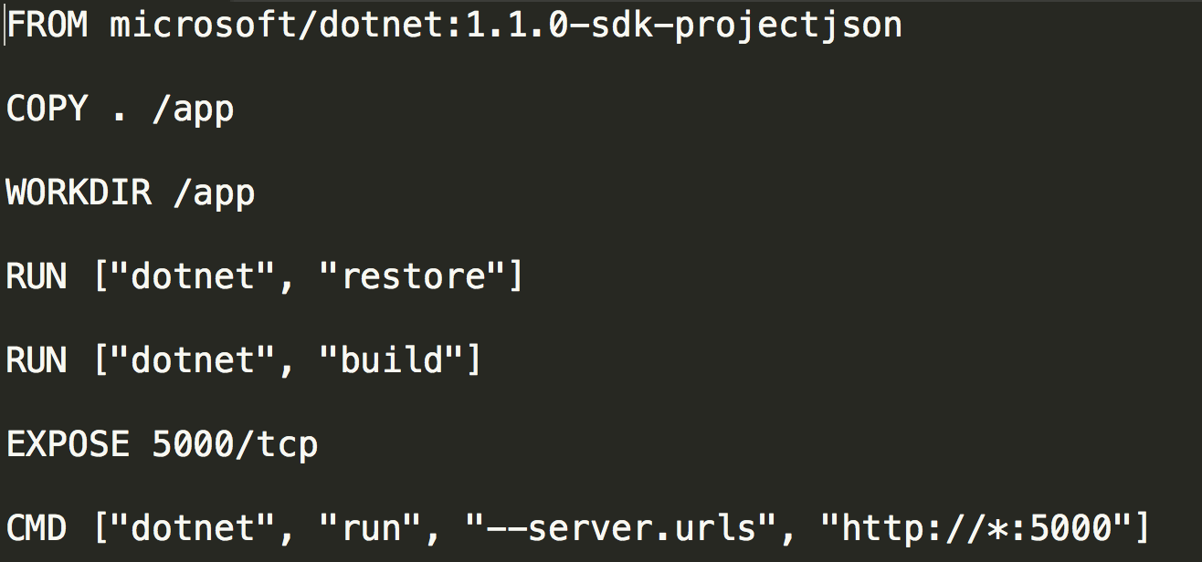
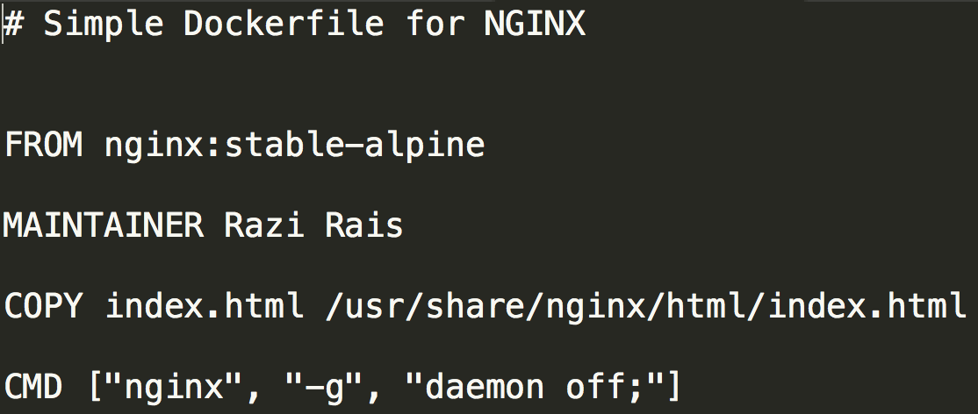
Dockerfile
Text file with Docker commands in it to create a new image. You can think of it as a configuration file with set of instructions needed to assemble a new image.
Docker has a docker build command that parses Dockerfile to build a new container image.
Notes:
Dockerfile ⬄ configuration file for container
It describes the container that can be built from it = its dependencies + how to start the container
docker build cmd=> read file and create image that can be run

Slide 40
Common Dockerfile Instructions
ADD instruction copies new files, directories or remote file URLs from <src> and adds them to the filesystem of the image at the path <dest>.
COPY instruction copies new files or directories from <src> and adds them to the filesystem of the container at the path <dest>.
CMD provide defaults for an executing container. These defaults can include an executable.
ENTRYPOINT allows you to configure a container that will run as an executable.
EXPOSE instruction informs Docker that the container listens on the specified network port(s).
FROM instruction initializes a new build stage and sets the Base Image for subsequent instructions.
LABEL is a key-value pair, stored as a string. You can specify multiple labels for an object, but each key-value pair must be unique within an object.
RUN will execute any commands in a new layer on top of the current image and commit the results.
WORKDIR instruction sets the working directory for any RUN, CMD, ENTRYPOINT, COPY and ADD instructions that follow it.
Notes:
Different instructions that can be found in Docker file
FROM: Base image or base OS used to host your system
LABEL: Key value pair to attach custom metadata to an image.
Example:
LABEL "com.example.vendor"="ACME Incorporated"
LABEL com.example.label-with-value="foo"
LABEL version="1.0"
RUN: set up commands to run when creating the container
=> example: install X, then install Y, …
WORDIR: name the directory in container where instructions will be applied
ADD and COPY: copy files to the container (Note: ADD can copy remote files as well)
CMD: Program that is going to run in the container (can be executable) (ping command)
ENTRYPOINT: Program that is going to run as an executable (dotnet yourProgram.dll)
EXPOSE: Open container port to the outside/host
https://docs.docker.com/engine/reference/builder
https://docs.docker.com/engine/reference/builder

Slide 41
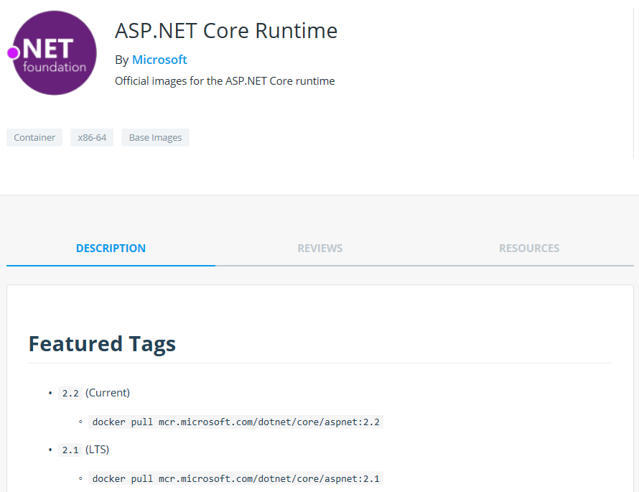
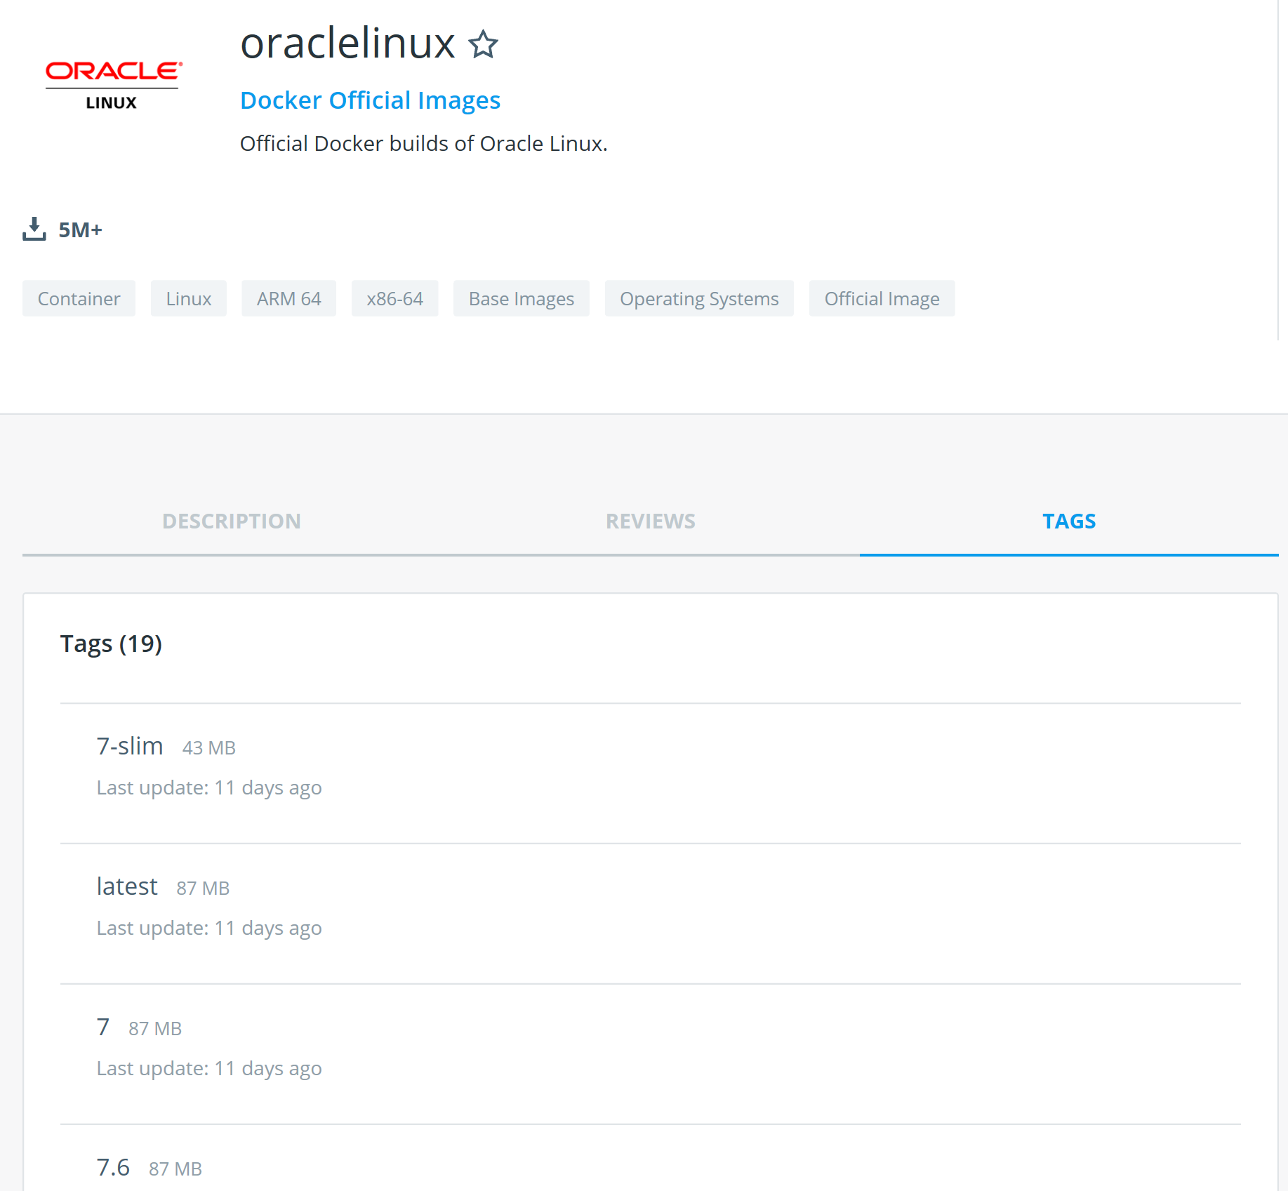
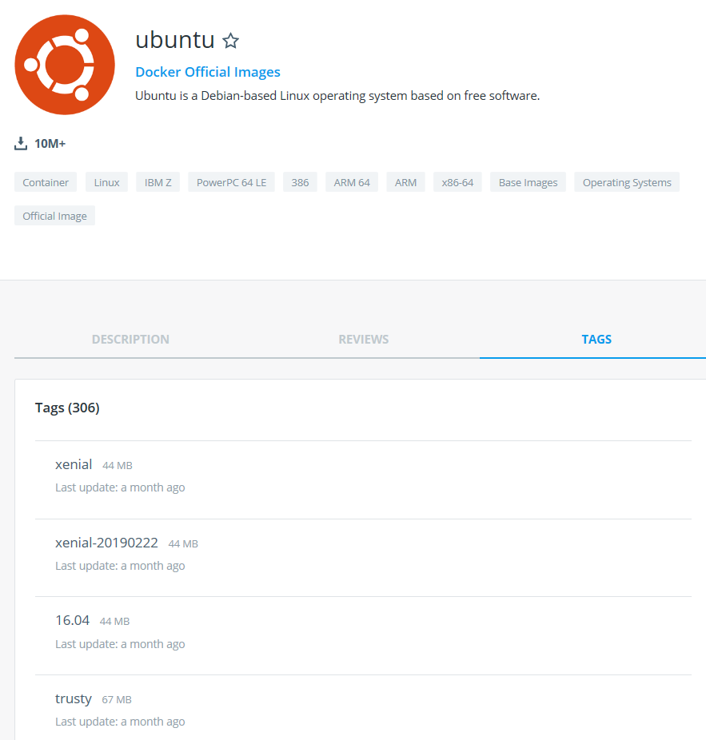
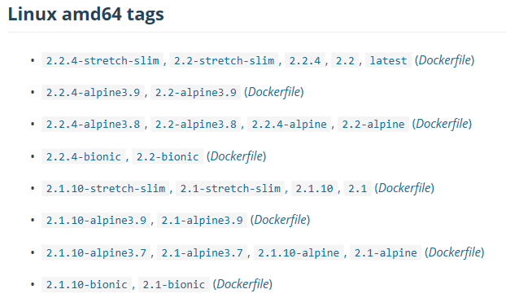
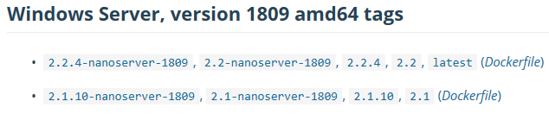
Image Tags
A Tag name is a string value that you can use to distinguish versions of your Docker images so you can preserve older copies or variants of a primary build.
You can group your images together using names and tags (if you don’t provide any tag default value of latest is assumed)
Notes:
Versioning
Opened/Flexible syntax => come up with your internal standard
Different approaches:
Oracle → Version number
Ubuntu → version number or distribution name (xenial, trusty, devel, …)
ASP .NET Core runtime → runtime version + OS version
Runtime version
Note: Microsoft .Net images are now pulled from Microsoft Container Registry (MCR) even though they are still referenced on Docker Hub.
Show : https://devblogs.microsoft.com/dotnet/net-core-container-images-now-published-to-microsoft-container-registry/

Slide 42
Demonstration: Dockerfile and Docker Build
Working with Dockerfile
Build container images using Docker build command:
- NodeJs
- Nginx
- ASP.NET Core
Using Image Tags
Notes:
For detail instructions please refer to Module 1 - Demos document section Demo 4: Inspecting Docker Layers

Slide 43



How does Docker build work?
Registry
DOCKER_HOST
dockerfile
Docker daemon
FROM microsoft/dotnet:1.0.0-rc2-core
WORKDIR /app
COPY /app /app
ENTRYPOINT dotnet AspCoreApp.dll
Containers
Images
Code/Binaries
0001Program.cs110
AspCoreApp.dll
111010111011011010
Client
Docker build
Docker run
Notes:
Docker workflow:
Docker build the image
- Based on dotnet -> grab it from registry
- Copy your binaries to the app folder
- Invoke dotnet CLI to start your application DLL
Docker run
- Instantiate the image and run it in a container

Slide 44
How does Docker build work?
Registry
DOCKER_HOST
dockerfile
Docker daemon
FROM microsoft/dotnet:1.0.0-rc2-core
WORKDIR /app
COPY /app /app
ENTRYPOINT dotnet AspCoreApp.dll
Containers
Images
Code/Binaries
0001Program.cs110
AspCoreApp.dll
111010111011011010
Client
Docker build
Docker run
Notes:
Docker workflow:
Docker build the image
- Based on dotnet -> grab it from registry
- Copy your binaries to the app folder
- Invoke dotnet CLI to start your application DLL
Docker run
- Instantiate the image and run it in a container

Slide 45
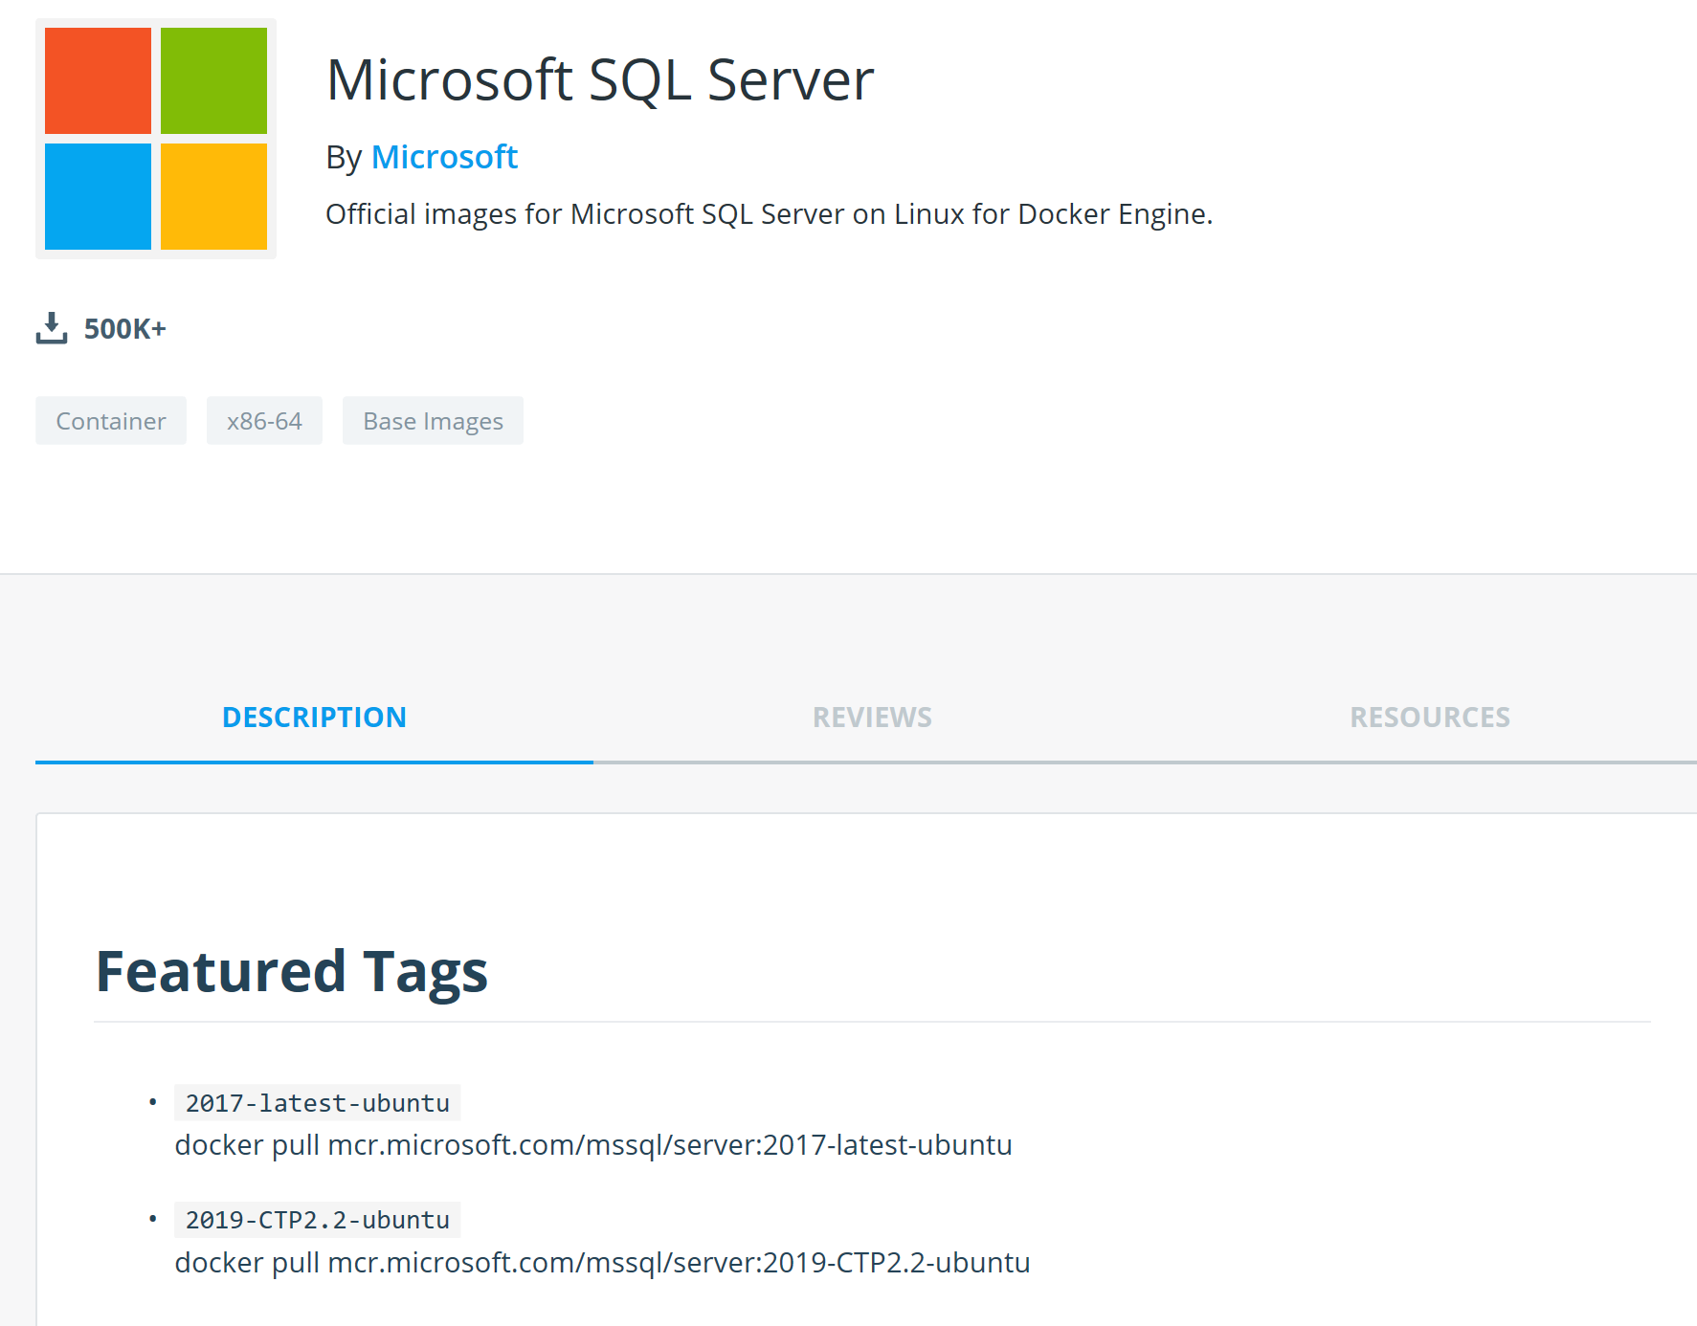
SQL Server 2017 Container Image
SQL Server in Linux can be packaged in a Docker container
Can be used in automated tests to pre-populate a SQL Server instance with test data on-demand
Can run on top of Ubuntu 16.04, RHEL and CentOS
Notes:
Aside from application, we can also package databases in containers.
Both SQL Server in Windows and Linux can be containerized => public image on Docker Hub
Linux image can run on top of Ubuntu 16.04, RHEL (preview) and CentOS (preview)
Surprising : pet vs cattle.
Used in the CI/CD pipeline of SQL Server PG.
Licensing:
Linux -> BYOL
Windows -> Only Express and Developer Editions => Free
More generally: can be interesting for testing. Even though there is no restriction to use them in production.
Note: Windows based images only run on top of Windows Server 2016 (kernel version lower than 1809) => Not recommended for production workload.
https://github.com/Microsoft/mssql-docker
https://hub.docker.com/_/microsoft-mssql-server

Slide 46
Demonstration: Running SQL Server 2017 inside Container
SQL Server 2017 Container Image
Using Custom Database with SQL Server 2017 running inside a Container
Notes:
Please refer to Module 1 – Demos document section Demo 5 for detail instructions about the demo.

Slide 47
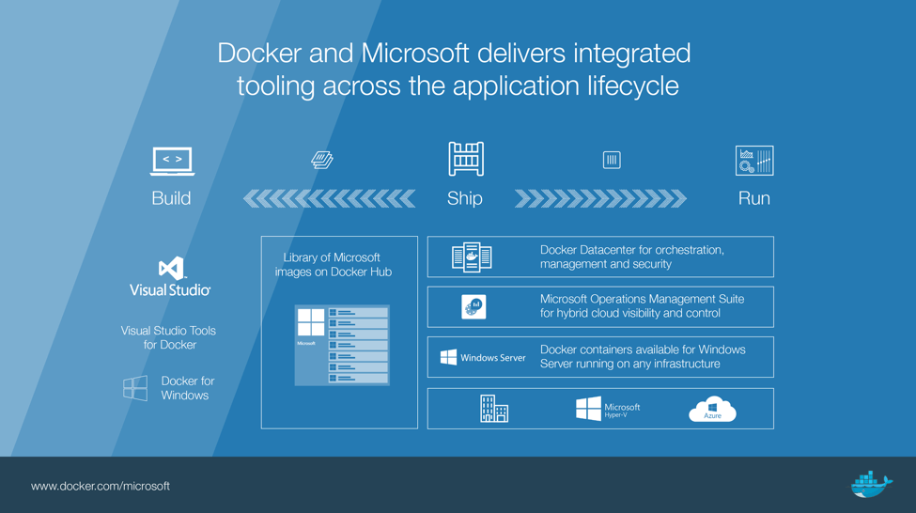
Docker and Microsoft Partnership
Docker Engine is tested, validated, and supported on Windows Server 2016/2019 and Windows 10 at no additional cost.
Microsoft provides Windows Server 2016/2019 customers enterprise support for Docker Enterprise Edition.
Docker is supported throughout Microsoft Cloud and on-premises ecosystem.
Notes:
Docker is a company
Became a standard => different partnerships in the industry
Microsoft and Docker
-> You can have Docker support in Microsoft Cloud and on premises.
MS built the windows-based images to allow Windows dev to work with Docker
Development of Windows containers (translation between Docker engine and OS.)
MS for OS expertise
Docker for Docker engine expertise (more in next module)
No Licensing cost for Windows base images
As long as License is paid for the host

Slide 48
Docker and Microsoft Partnership (Cont.)
For developers, the integration of Visual Studio Tools for Docker and Docker Desktop provides complete desktop development environments for building Dockerized Windows apps
To jumpstart app development, Microsoft has contributed Windows Server container base images and apps to Docker Hub
For IT pros, Docker Enterprise for Azure is designed to manage Windows Server environments in addition to the Linux environments with the Docker Universal Control Plane
Notes:
Strong integration of Docker with Visual Studio
Docker Desktop => Build Linux or Windows based containers on Windows Dev machine
Docker Enterprise for Azure => one-click deploy of highly scalable Docker Enterprise based on Docker and Azure best practices
Resources: https://azuremarketplace.microsoft.com/en-us/marketplace/apps/docker.dockerdatacenter

Slide 49
Lab: Introduction to Containers
90 Minutes
Running Your First Container
Working with Docker Command Line Interface (CLI)
Building Custom Container Images with Dockerfile
Interaction with a Running Container
Tagging
Notes:
For detail instructions please refer to Module 1 – Lab document.

